Slide 1
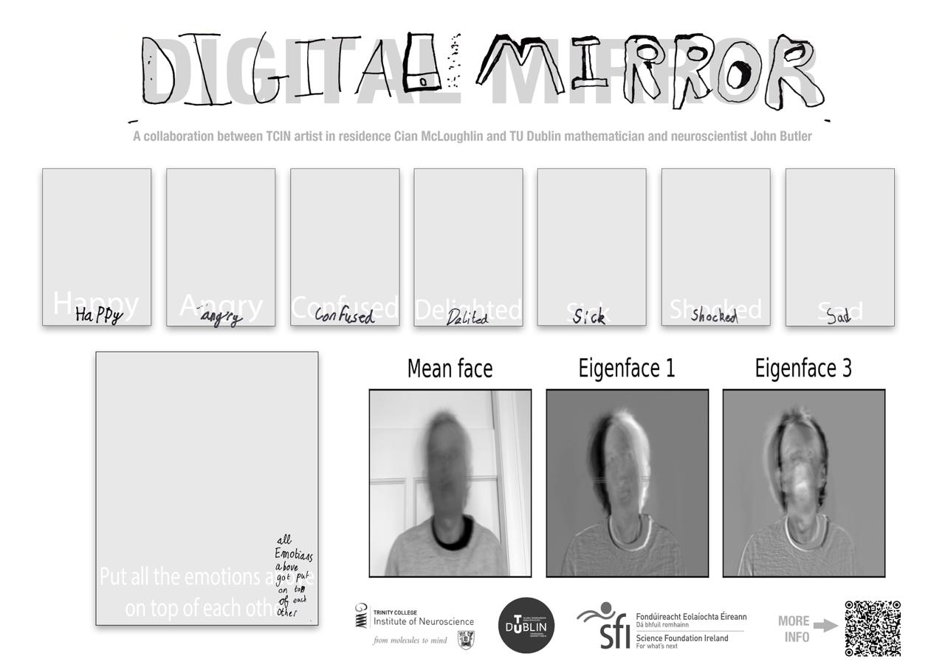

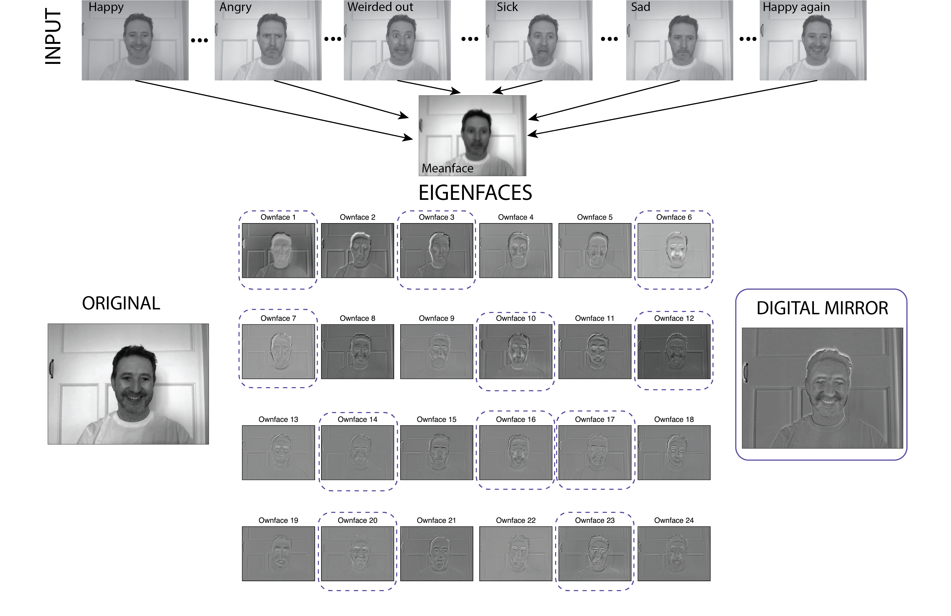
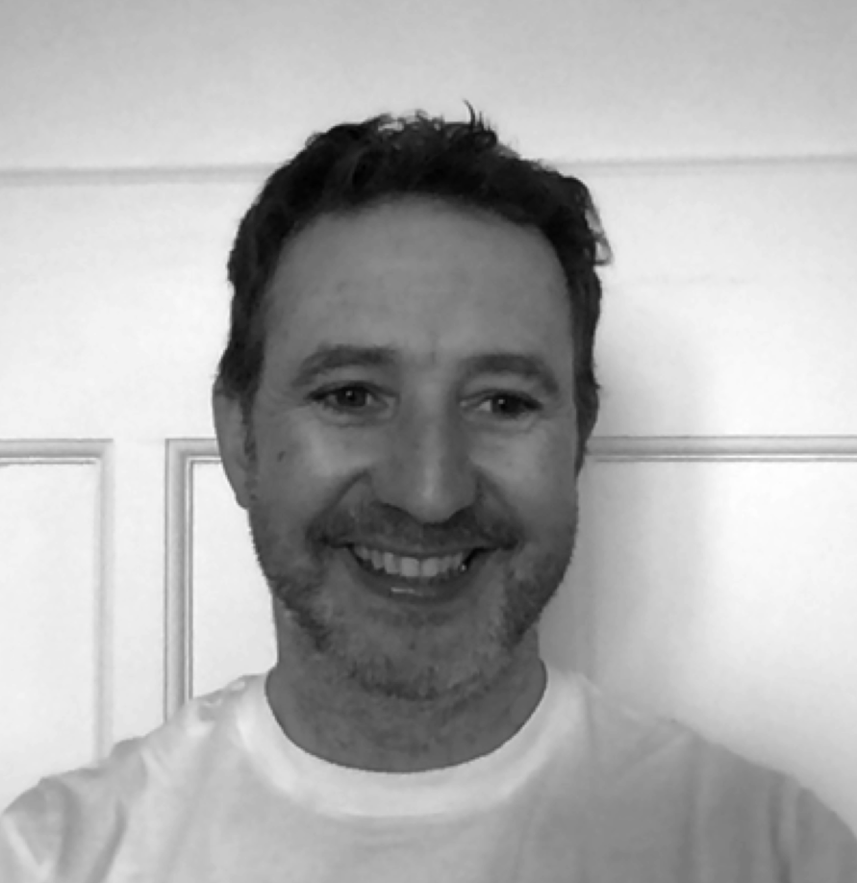
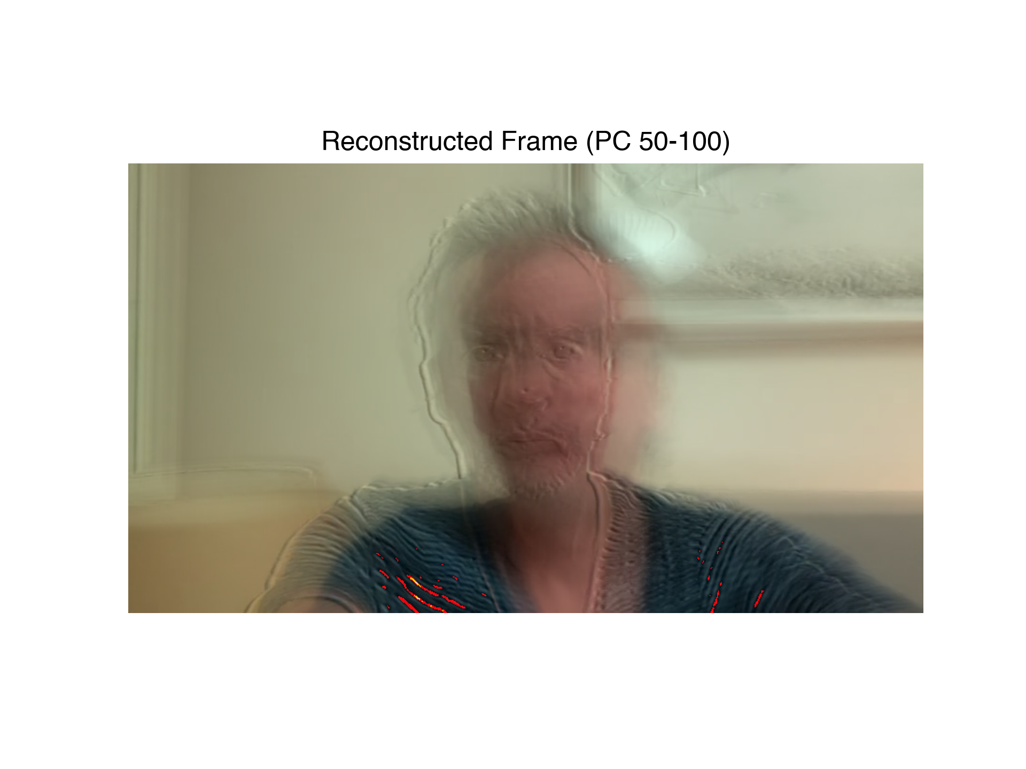
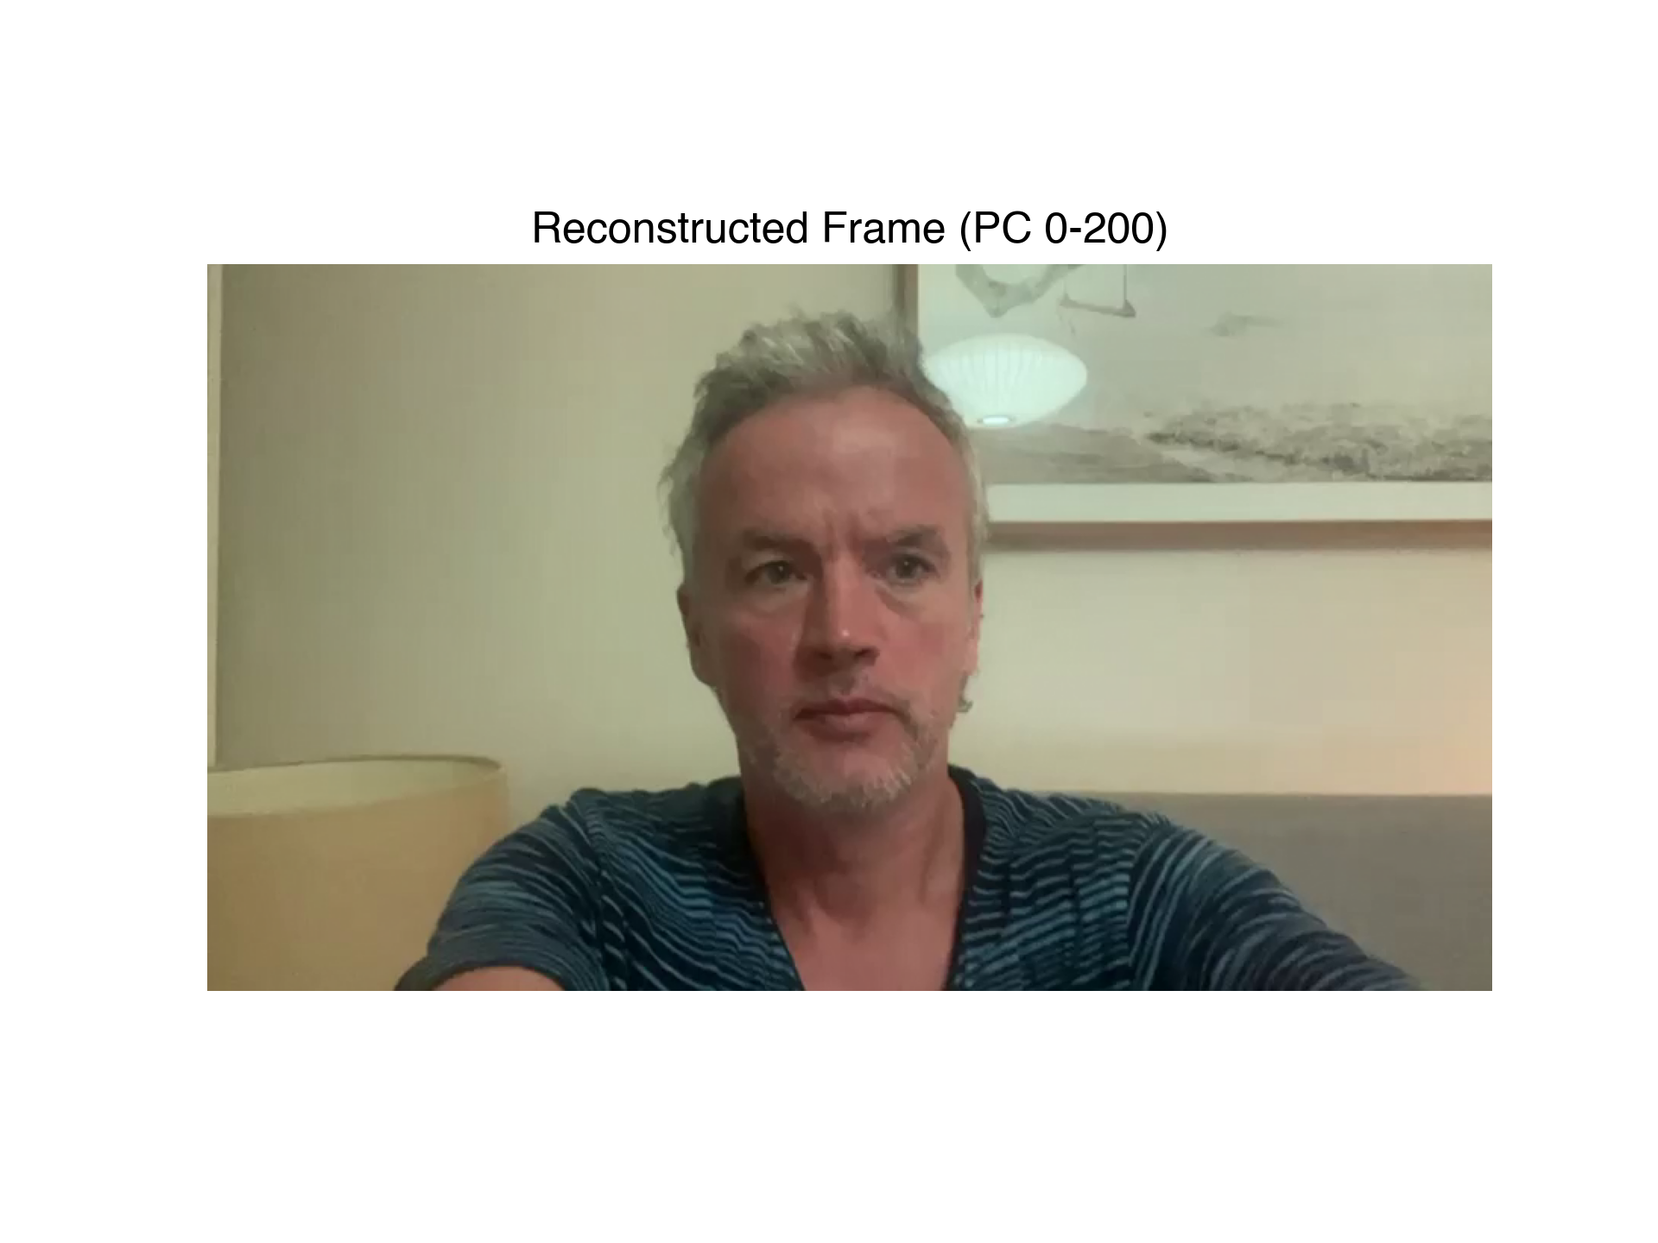
AI and the evolution of Portraiture
John Butler TU Dublin, School of Mathematics and Statistics
Cian McLoughlin National College of Art and Design
Trinity College Institute of Neuroscience

Slide 2
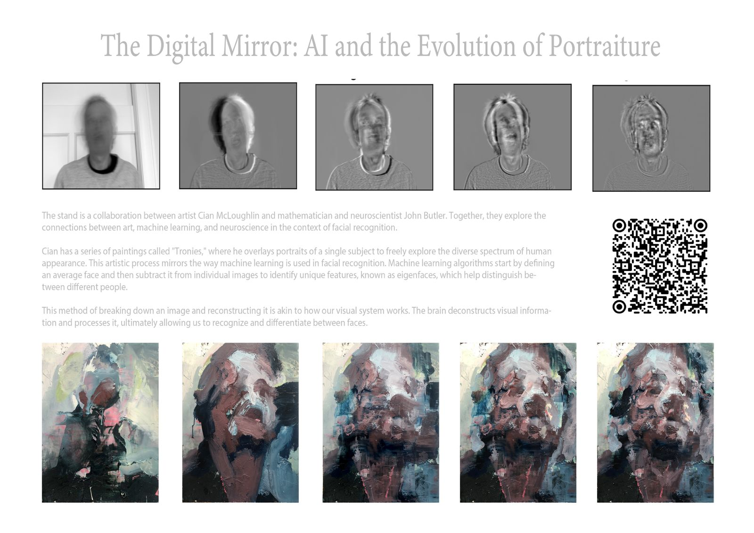
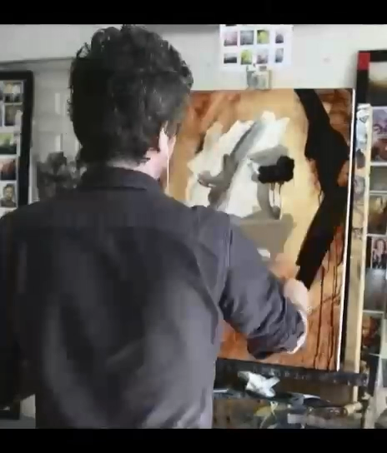
Cian Painting a Portrait
Eigenface
Ownface

Slide 3
Face Recognition
Capturing the Essence (Art)
How the Brain Recognises People (Neuroscience)
How a Computer Sees You (Maths)
How a Computer Recognises You (Machine Learning)

Slide 4
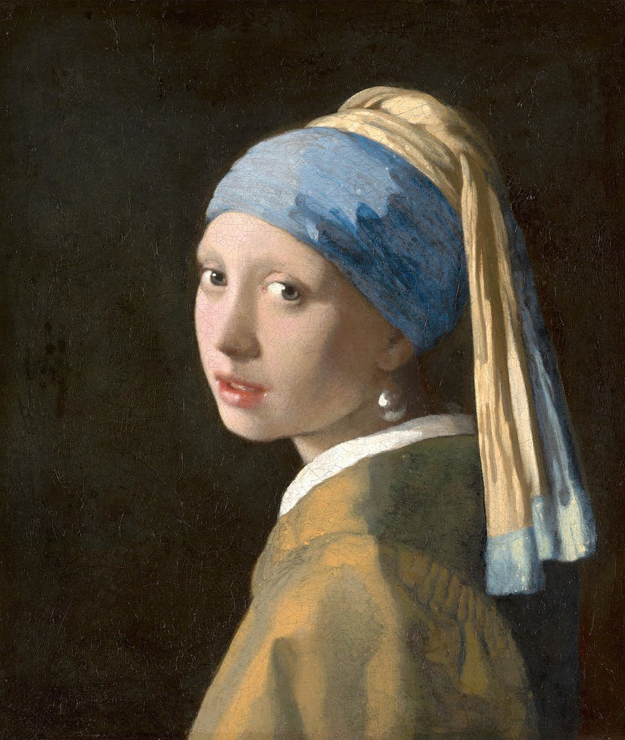
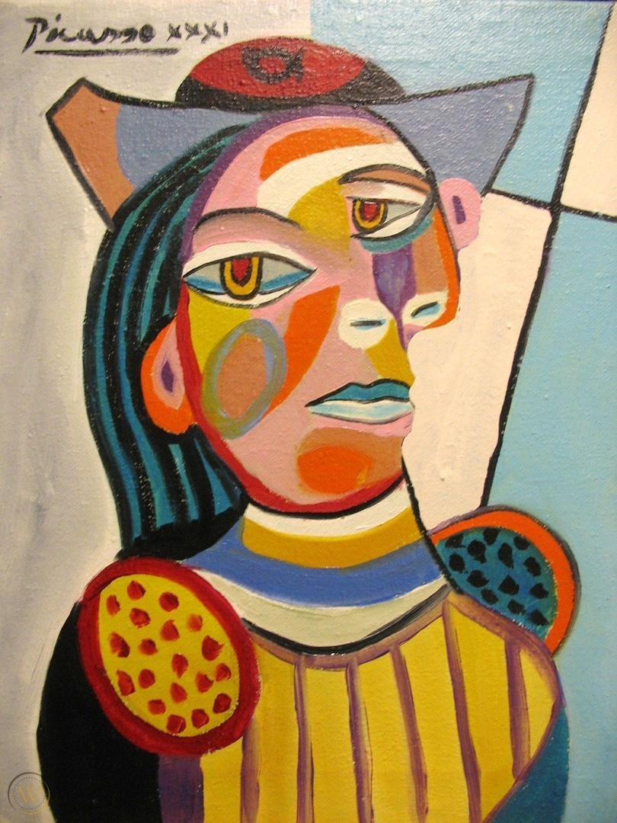
Capture the Essence (Art)
Johannes Vermeer 1600s
Pablo Picasso 1900s
Notes:
The goal of a portrait painting is to capture the essence, personality, and physical likeness of a subject.

Slide 5
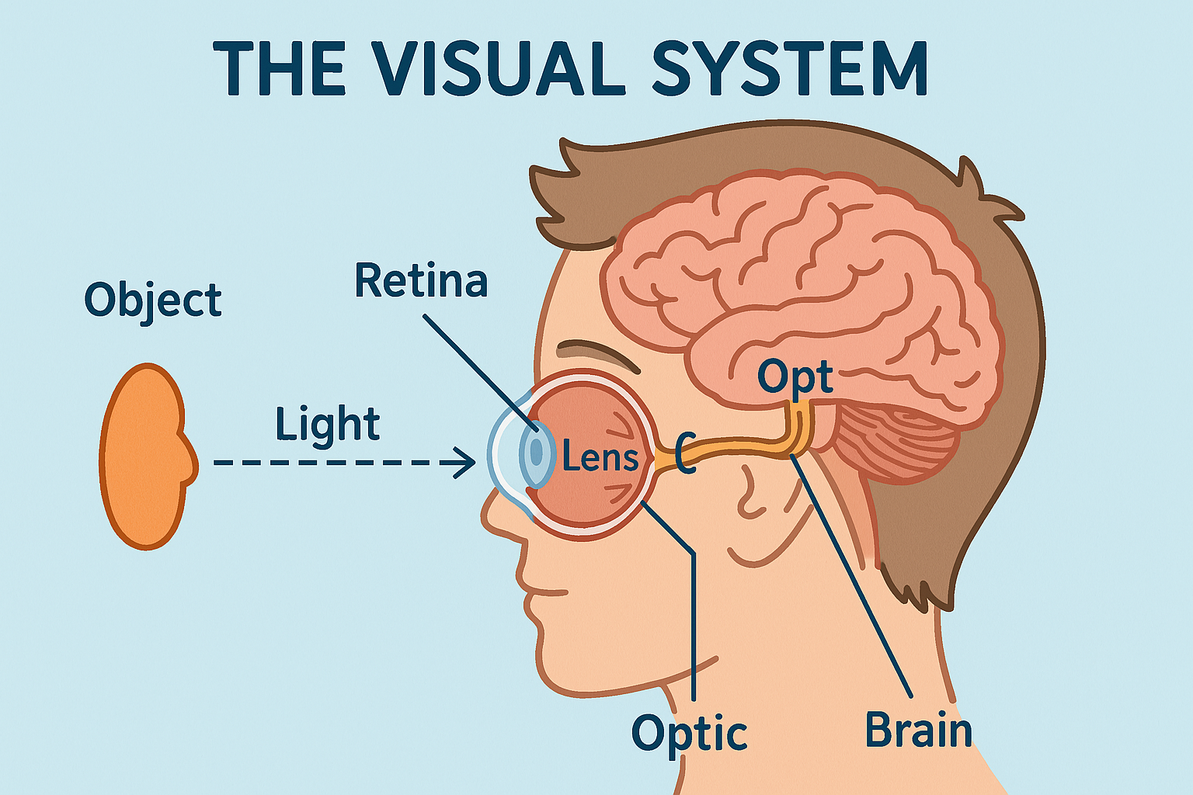
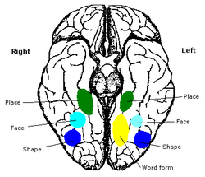
How the Brain Recognises People (Neuroscience)
Fusiform Face Area

Slide 6
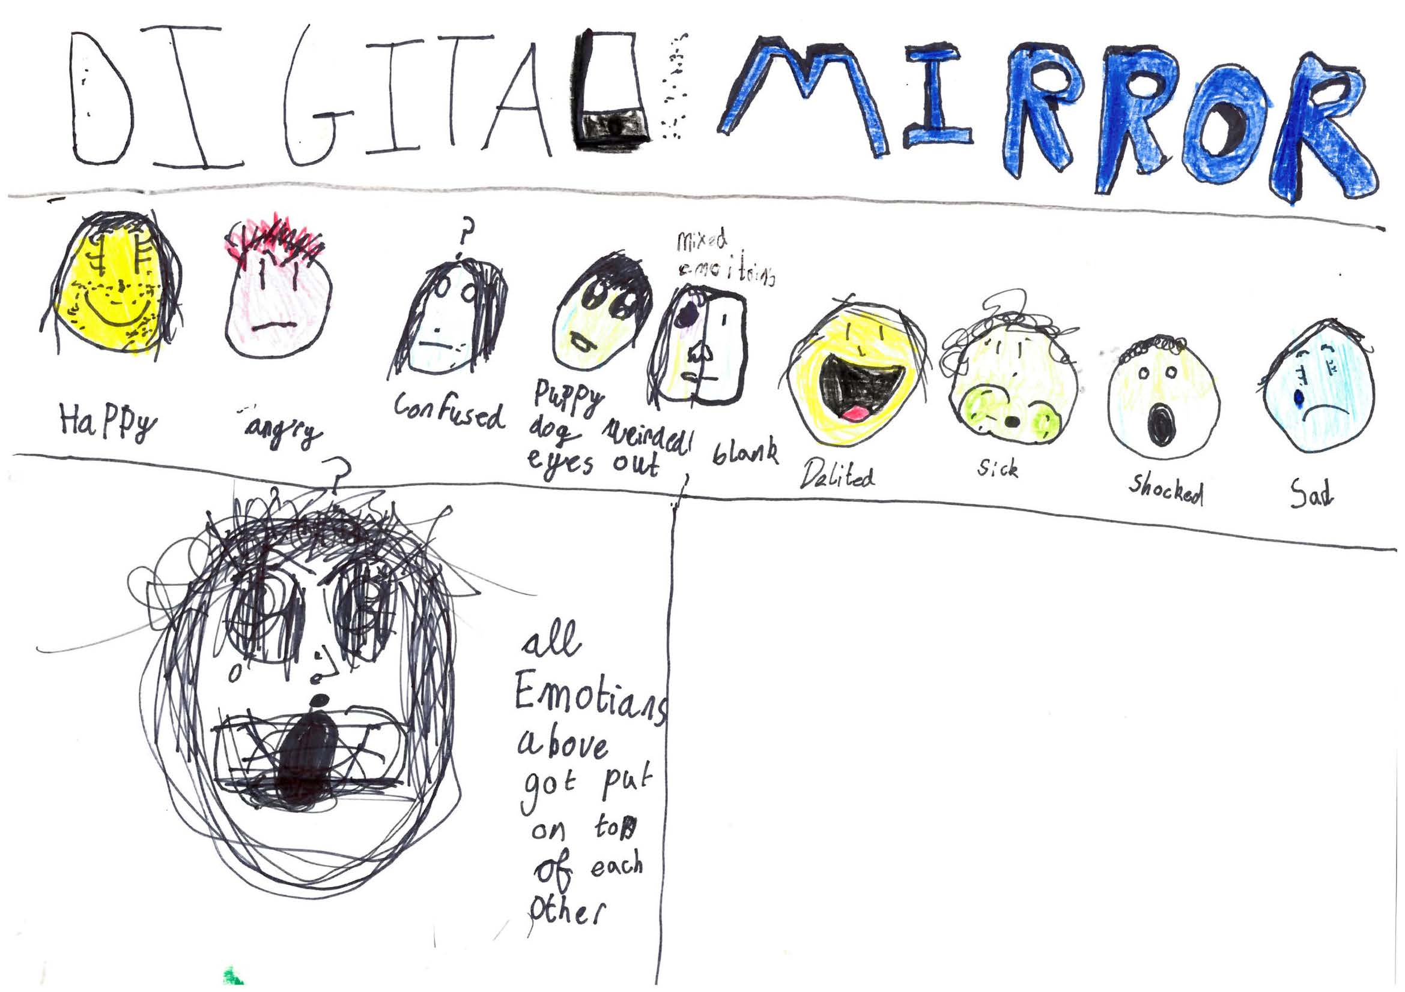
Knowing Me Knowing You
Tá athas orm
Tá brón orm
Mean face

Slide 7
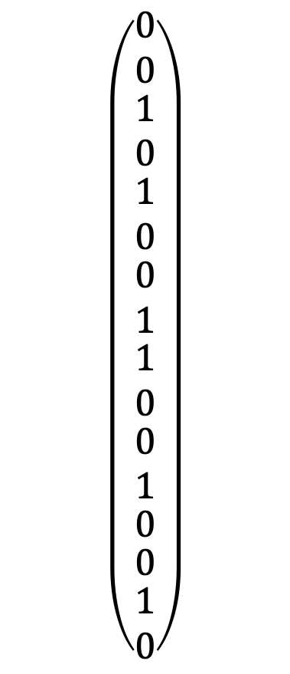
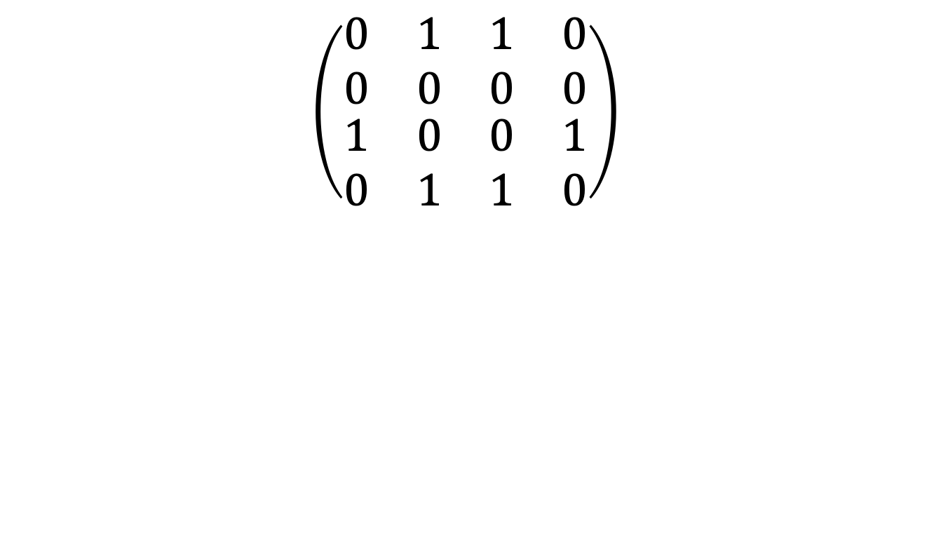
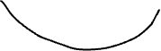
How a computer sees you (Maths)
$$\left(\begin{matrix}\begin{matrix}\begin{matrix}\begin{matrix}0 \\ 0\end{matrix} \\ \begin{matrix}1 \\ 0\end{matrix}\end{matrix} \\ \begin{matrix}\begin{matrix}1 \\ 0\end{matrix} \\ \begin{matrix}0 \\ 1\end{matrix}\end{matrix}\end{matrix} \\ \begin{matrix}\begin{matrix}\begin{matrix}\begin{matrix}1 \\ 0\end{matrix} \\ \begin{matrix}0 \\ 1\end{matrix}\end{matrix} \\ 0\end{matrix} \\ \begin{matrix}0 \\ \begin{matrix}1 \\ 0\end{matrix}\end{matrix}\end{matrix}\end{matrix}\right)$$
$$\left(\begin{matrix}\begin{matrix}0 & 1 \\ 0 & 0\end{matrix} & \begin{matrix}1 & 0 \\ 0 & 0\end{matrix} \\ \begin{matrix}1 & 0 \\ 0 & 1\end{matrix} & \begin{matrix}0 & 1 \\ 1 & 0\end{matrix}\end{matrix}\right)$$

Slide 8
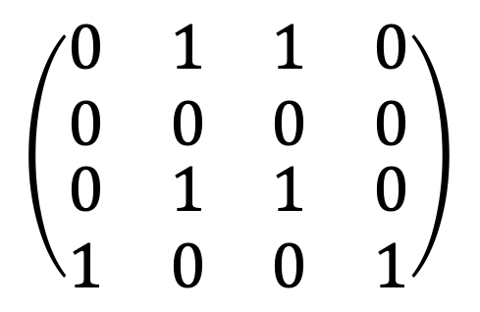
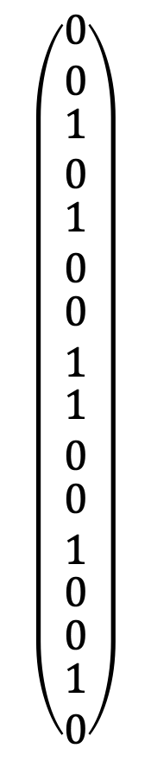
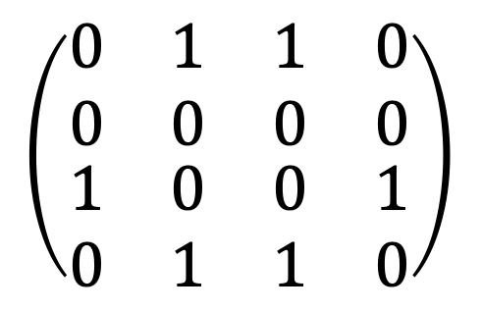
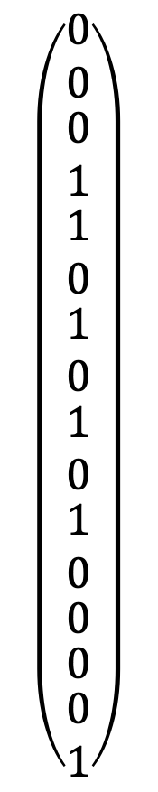
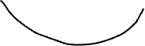
Different Faces
$$\left(\begin{matrix}\begin{matrix}0 & 1 \\ 0 & 0\end{matrix} & \begin{matrix}1 & 0 \\ 0 & 0\end{matrix} \\ \begin{matrix}1 & 0 \\ 0 & 1\end{matrix} & \begin{matrix}0 & 1 \\ 1 & 0\end{matrix}\end{matrix}\right)$$
$$\left(\begin{matrix}\begin{matrix}\begin{matrix}\begin{matrix}0 \\ 0\end{matrix} \\ \begin{matrix}1 \\ 0\end{matrix}\end{matrix} \\ \begin{matrix}\begin{matrix}1 \\ 0\end{matrix} \\ \begin{matrix}0 \\ 1\end{matrix}\end{matrix}\end{matrix} \\ \begin{matrix}\begin{matrix}\begin{matrix}\begin{matrix}1 \\ 0\end{matrix} \\ \begin{matrix}0 \\ 1\end{matrix}\end{matrix} \\ 0\end{matrix} \\ \begin{matrix}0 \\ \begin{matrix}1 \\ 0\end{matrix}\end{matrix}\end{matrix}\end{matrix}\right)$$
$$\left(\begin{matrix}\begin{matrix}0 & 1 \\ 0 & 0\end{matrix} & \begin{matrix}1 & 0 \\ 0 & 0\end{matrix} \\ \begin{matrix}0 & 1 \\ 1 & 0\end{matrix} & \begin{matrix}1 & 0 \\ 0 & 1\end{matrix}\end{matrix}\right)$$
$$\left(\begin{matrix}\begin{matrix}\begin{matrix}\begin{matrix}0 \\ 0\end{matrix} \\ \begin{matrix}0 \\ 1\end{matrix}\end{matrix} \\ \begin{matrix}\begin{matrix}1 \\ 0\end{matrix} \\ \begin{matrix}1 \\ 0\end{matrix}\end{matrix}\end{matrix} \\ \begin{matrix}\begin{matrix}\begin{matrix}\begin{matrix}1 \\ 0\end{matrix} \\ \begin{matrix}1 \\ 0\end{matrix}\end{matrix} \\ 0\end{matrix} \\ \begin{matrix}0 \\ \begin{matrix}0 \\ 1\end{matrix}\end{matrix}\end{matrix}\end{matrix}\right)$$

Slide 9
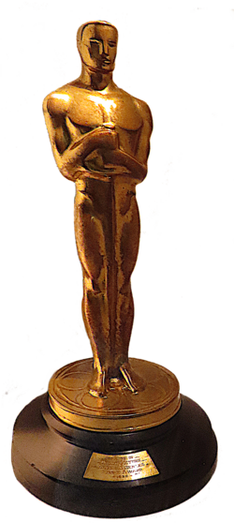
I Would Like to Thank the Academy
640x480= 307200
450 faces in 15s

Slide 10
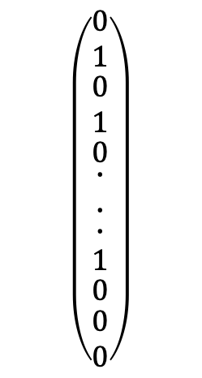
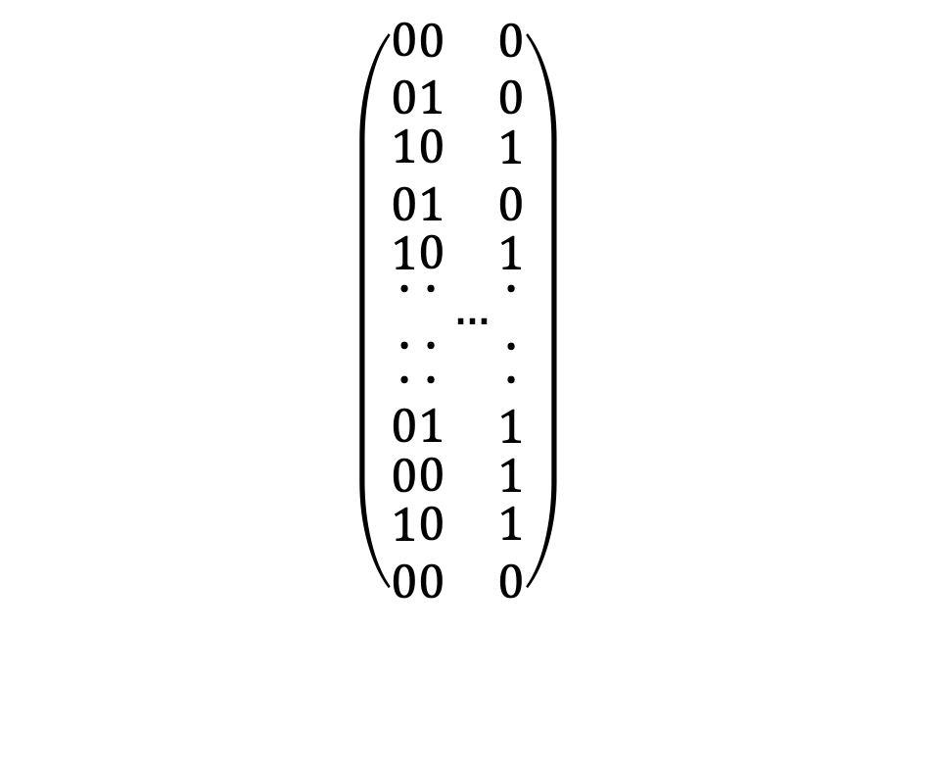
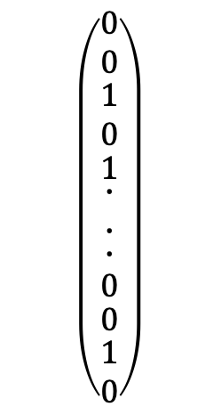
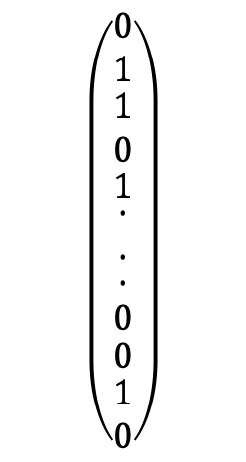
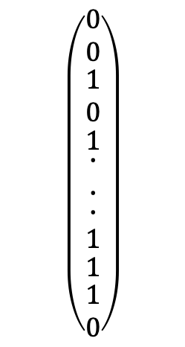
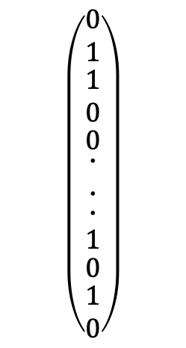
We Need Loads of Faces (Machine Learning)
$$\left(\begin{matrix}\begin{matrix}\begin{matrix}\begin{matrix}0 \\ 0\end{matrix} \\ \begin{matrix}1 \\ 0\end{matrix}\end{matrix} \\ 1\end{matrix} \\ \begin{matrix}\begin{matrix}\begin{matrix}\begin{matrix}∙ \\ ∙\end{matrix} \\ ∙\end{matrix} \\ 0\end{matrix} \\ \begin{matrix}0 \\ \begin{matrix}1 \\ 0\end{matrix}\end{matrix}\end{matrix}\end{matrix}\begin{matrix}\begin{matrix}\begin{matrix}\begin{matrix}0 \\ 1\end{matrix} \\ \begin{matrix}0 \\ 1\end{matrix}\end{matrix} \\ 0\end{matrix} \\ \begin{matrix}\begin{matrix}\begin{matrix}\begin{matrix}∙ \\ ∙\end{matrix} \\ ∙\end{matrix} \\ 1\end{matrix} \\ \begin{matrix}0 \\ \begin{matrix}0 \\ 0\end{matrix}\end{matrix}\end{matrix}\end{matrix}…\begin{matrix}\begin{matrix}\begin{matrix}\begin{matrix}0 \\ 0\end{matrix} \\ \begin{matrix}1 \\ 0\end{matrix}\end{matrix} \\ 1\end{matrix} \\ \begin{matrix}\begin{matrix}\begin{matrix}\begin{matrix}∙ \\ ∙\end{matrix} \\ ∙\end{matrix} \\ 1\end{matrix} \\ \begin{matrix}1 \\ \begin{matrix}1 \\ 0\end{matrix}\end{matrix}\end{matrix}\end{matrix}\right)$$
$$\left(\begin{matrix}\begin{matrix}\begin{matrix}\begin{matrix}0 \\ 0\end{matrix} \\ \begin{matrix}1 \\ 0\end{matrix}\end{matrix} \\ 1\end{matrix} \\ \begin{matrix}\begin{matrix}\begin{matrix}\begin{matrix}∙ \\ ∙\end{matrix} \\ ∙\end{matrix} \\ 0\end{matrix} \\ \begin{matrix}0 \\ \begin{matrix}1 \\ 0\end{matrix}\end{matrix}\end{matrix}\end{matrix}\right)$$
$$\left(\begin{matrix}\begin{matrix}\begin{matrix}\begin{matrix}0 \\ 1\end{matrix} \\ \begin{matrix}0 \\ 1\end{matrix}\end{matrix} \\ 0\end{matrix} \\ \begin{matrix}\begin{matrix}\begin{matrix}\begin{matrix}∙ \\ ∙\end{matrix} \\ ∙\end{matrix} \\ 1\end{matrix} \\ \begin{matrix}0 \\ \begin{matrix}0 \\ 0\end{matrix}\end{matrix}\end{matrix}\end{matrix}\right)$$
$$\left(\begin{matrix}\begin{matrix}\begin{matrix}\begin{matrix}0 \\ 1\end{matrix} \\ \begin{matrix}1 \\ 0\end{matrix}\end{matrix} \\ 0\end{matrix} \\ \begin{matrix}\begin{matrix}\begin{matrix}\begin{matrix}∙ \\ ∙\end{matrix} \\ ∙\end{matrix} \\ 1\end{matrix} \\ \begin{matrix}0 \\ \begin{matrix}1 \\ 0\end{matrix}\end{matrix}\end{matrix}\end{matrix}\right)$$
$$\left(\begin{matrix}\begin{matrix}\begin{matrix}\begin{matrix}0 \\ 0\end{matrix} \\ \begin{matrix}1 \\ 0\end{matrix}\end{matrix} \\ 1\end{matrix} \\ \begin{matrix}\begin{matrix}\begin{matrix}\begin{matrix}∙ \\ ∙\end{matrix} \\ ∙\end{matrix} \\ 1\end{matrix} \\ \begin{matrix}1 \\ \begin{matrix}1 \\ 0\end{matrix}\end{matrix}\end{matrix}\end{matrix}\right)$$
$$\left(\begin{matrix}\begin{matrix}\begin{matrix}\begin{matrix}0 \\ 1\end{matrix} \\ \begin{matrix}1 \\ 0\end{matrix}\end{matrix} \\ 1\end{matrix} \\ \begin{matrix}\begin{matrix}\begin{matrix}\begin{matrix}∙ \\ ∙\end{matrix} \\ ∙\end{matrix} \\ 0\end{matrix} \\ \begin{matrix}0 \\ \begin{matrix}1 \\ 0\end{matrix}\end{matrix}\end{matrix}\end{matrix}\right)$$
307200x450

Slide 11
Average Looking

Slide 12
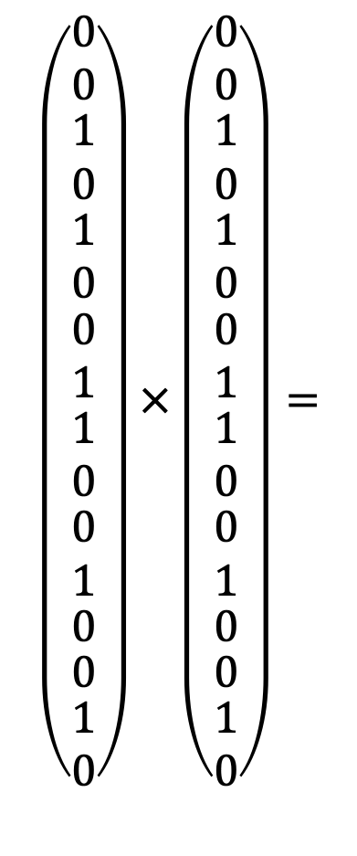

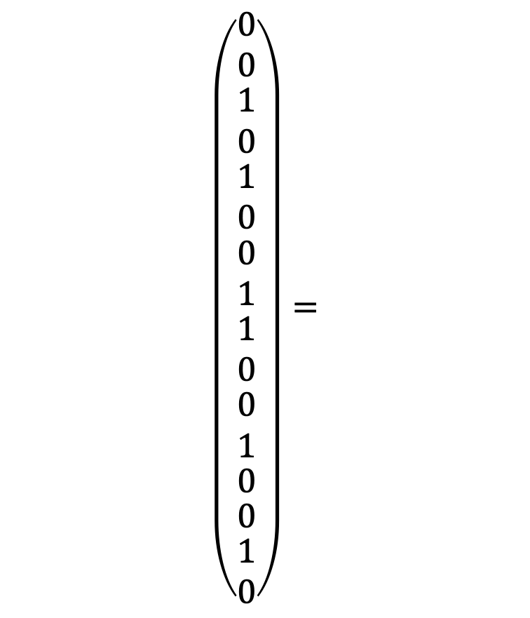

Comparing Images
$$\left(\begin{matrix}\begin{matrix}\begin{matrix}\begin{matrix}0 \\ 0\end{matrix} \\ \begin{matrix}1 \\ 0\end{matrix}\end{matrix} \\ \begin{matrix}\begin{matrix}1 \\ 0\end{matrix} \\ \begin{matrix}0 \\ 1\end{matrix}\end{matrix}\end{matrix} \\ \begin{matrix}\begin{matrix}\begin{matrix}\begin{matrix}1 \\ 0\end{matrix} \\ \begin{matrix}0 \\ 1\end{matrix}\end{matrix} \\ 0\end{matrix} \\ \begin{matrix}0 \\ \begin{matrix}1 \\ 0\end{matrix}\end{matrix}\end{matrix}\end{matrix}\right)×\left(\begin{matrix}\begin{matrix}\begin{matrix}\begin{matrix}0 \\ 0\end{matrix} \\ \begin{matrix}1 \\ 0\end{matrix}\end{matrix} \\ \begin{matrix}\begin{matrix}1 \\ 0\end{matrix} \\ \begin{matrix}0 \\ 1\end{matrix}\end{matrix}\end{matrix} \\ \begin{matrix}\begin{matrix}\begin{matrix}\begin{matrix}1 \\ 0\end{matrix} \\ \begin{matrix}0 \\ 1\end{matrix}\end{matrix} \\ 0\end{matrix} \\ \begin{matrix}0 \\ \begin{matrix}1 \\ 0\end{matrix}\end{matrix}\end{matrix}\end{matrix}\right)=$$
$$\left(\begin{matrix}\begin{matrix}\begin{matrix}\begin{matrix}0 \\ 0\end{matrix} \\ \begin{matrix}1 \\ 0\end{matrix}\end{matrix} \\ \begin{matrix}\begin{matrix}1 \\ 0\end{matrix} \\ \begin{matrix}0 \\ 1\end{matrix}\end{matrix}\end{matrix} \\ \begin{matrix}\begin{matrix}\begin{matrix}\begin{matrix}1 \\ 0\end{matrix} \\ \begin{matrix}0 \\ 1\end{matrix}\end{matrix} \\ 0\end{matrix} \\ \begin{matrix}0 \\ \begin{matrix}1 \\ 0\end{matrix}\end{matrix}\end{matrix}\end{matrix}\right)=$$
$$6$$
$$×$$

Slide 13
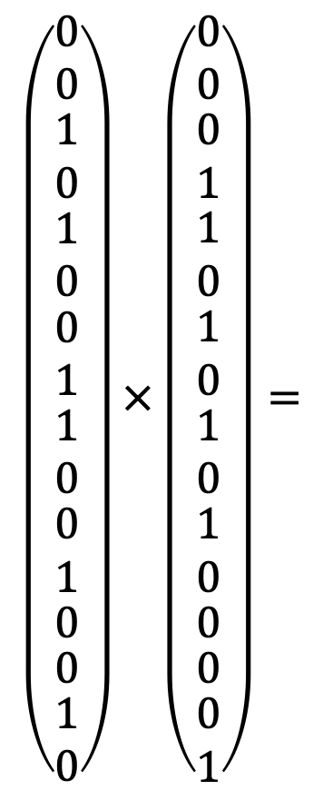

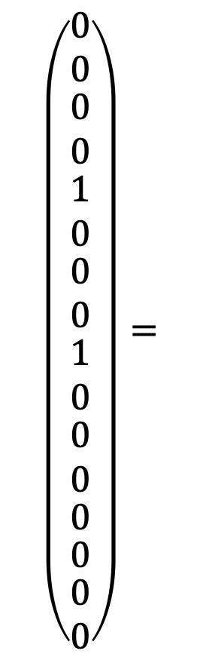

Different Images
$$\left(\begin{matrix}\begin{matrix}\begin{matrix}\begin{matrix}0 \\ 0\end{matrix} \\ \begin{matrix}1 \\ 0\end{matrix}\end{matrix} \\ \begin{matrix}\begin{matrix}1 \\ 0\end{matrix} \\ \begin{matrix}0 \\ 1\end{matrix}\end{matrix}\end{matrix} \\ \begin{matrix}\begin{matrix}\begin{matrix}\begin{matrix}1 \\ 0\end{matrix} \\ \begin{matrix}0 \\ 1\end{matrix}\end{matrix} \\ 0\end{matrix} \\ \begin{matrix}0 \\ \begin{matrix}1 \\ 0\end{matrix}\end{matrix}\end{matrix}\end{matrix}\right)×\left(\begin{matrix}\begin{matrix}\begin{matrix}\begin{matrix}0 \\ 0\end{matrix} \\ \begin{matrix}0 \\ 1\end{matrix}\end{matrix} \\ \begin{matrix}\begin{matrix}1 \\ 0\end{matrix} \\ \begin{matrix}1 \\ 0\end{matrix}\end{matrix}\end{matrix} \\ \begin{matrix}\begin{matrix}\begin{matrix}\begin{matrix}1 \\ 0\end{matrix} \\ \begin{matrix}1 \\ 0\end{matrix}\end{matrix} \\ 0\end{matrix} \\ \begin{matrix}0 \\ \begin{matrix}0 \\ 1\end{matrix}\end{matrix}\end{matrix}\end{matrix}\right)=$$
$$\left(\begin{matrix}\begin{matrix}\begin{matrix}\begin{matrix}0 \\ 0\end{matrix} \\ \begin{matrix}0 \\ 0\end{matrix}\end{matrix} \\ \begin{matrix}\begin{matrix}1 \\ 0\end{matrix} \\ \begin{matrix}0 \\ 0\end{matrix}\end{matrix}\end{matrix} \\ \begin{matrix}\begin{matrix}\begin{matrix}\begin{matrix}1 \\ 0\end{matrix} \\ \begin{matrix}0 \\ 0\end{matrix}\end{matrix} \\ 0\end{matrix} \\ \begin{matrix}0 \\ \begin{matrix}0 \\ 0\end{matrix}\end{matrix}\end{matrix}\end{matrix}\right)=$$
$$×$$
$$2$$

Slide 14
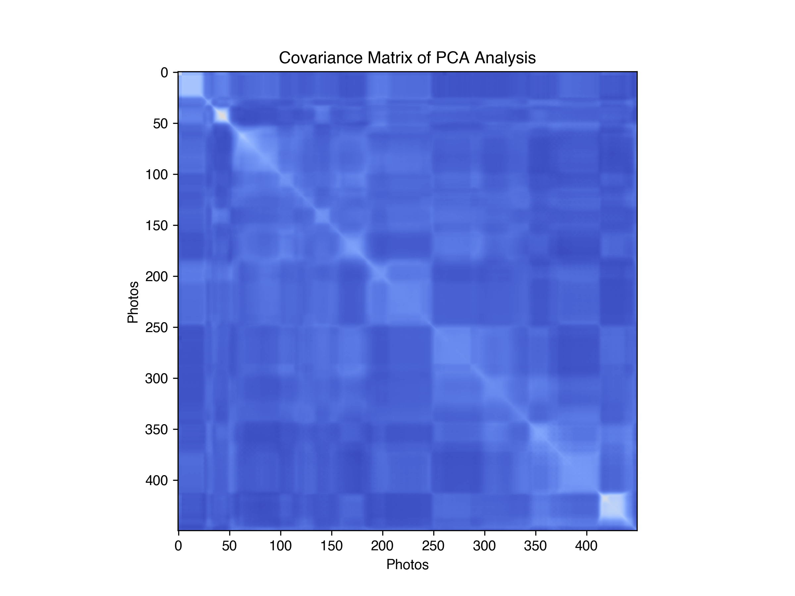
What Looks the Same
Essence bit of the thing
Happy
Angry
Confused
Puppy Dog
450x450
Weirded Out
Delighted
Sick
Shocked
Happy
Sad
Angry
Confused
Puppy Dog
Weirded Out
Delighted
Sick
Shocked
Sad

Slide 15
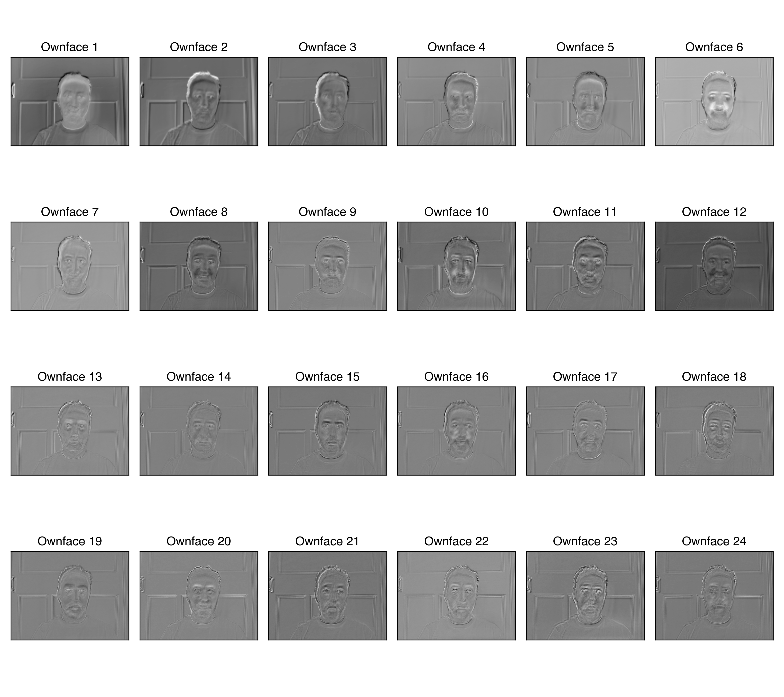
Eigenface (Ownface)

Slide 16
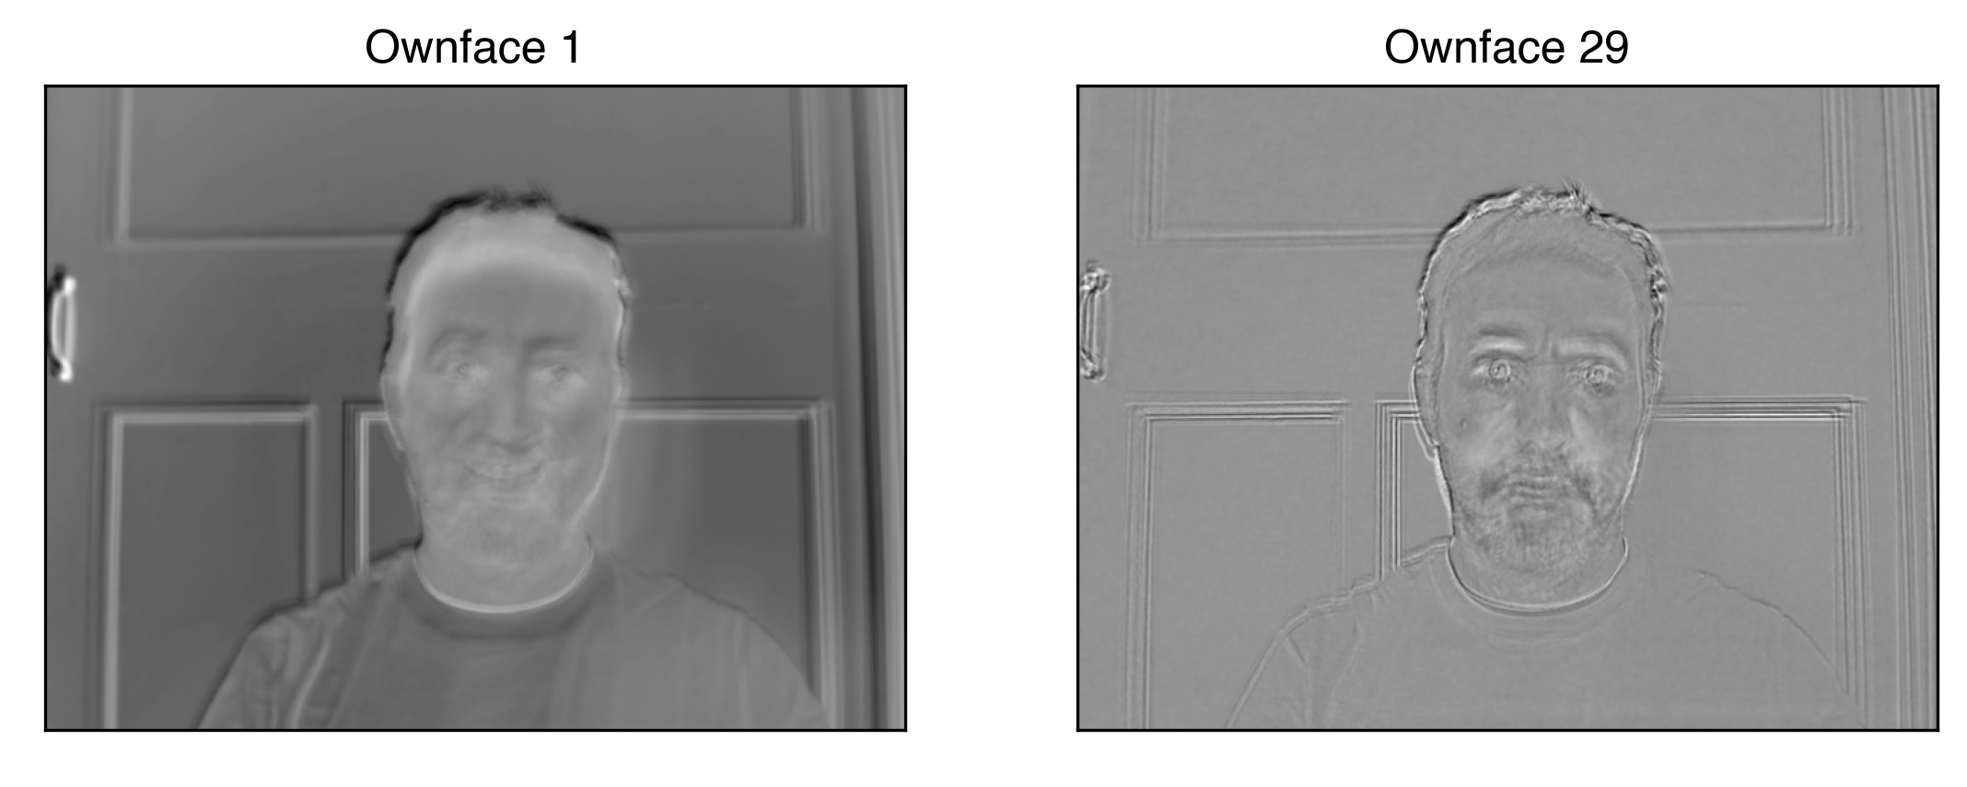
True You

Slide 17
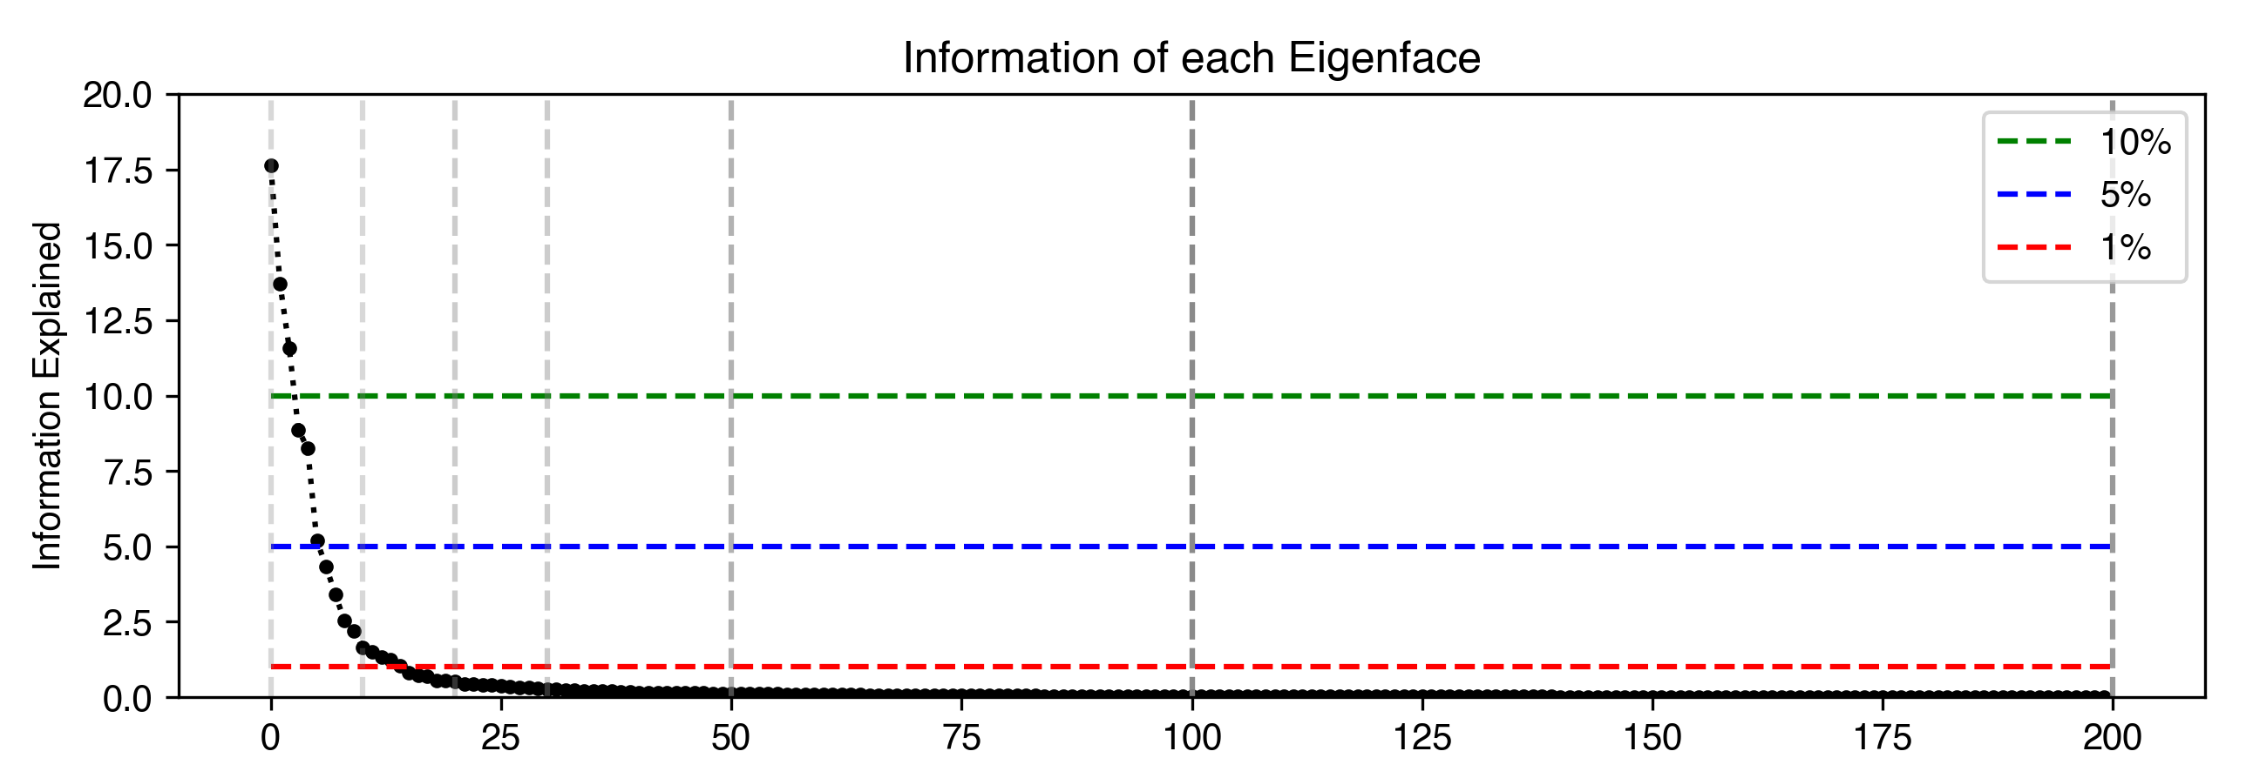
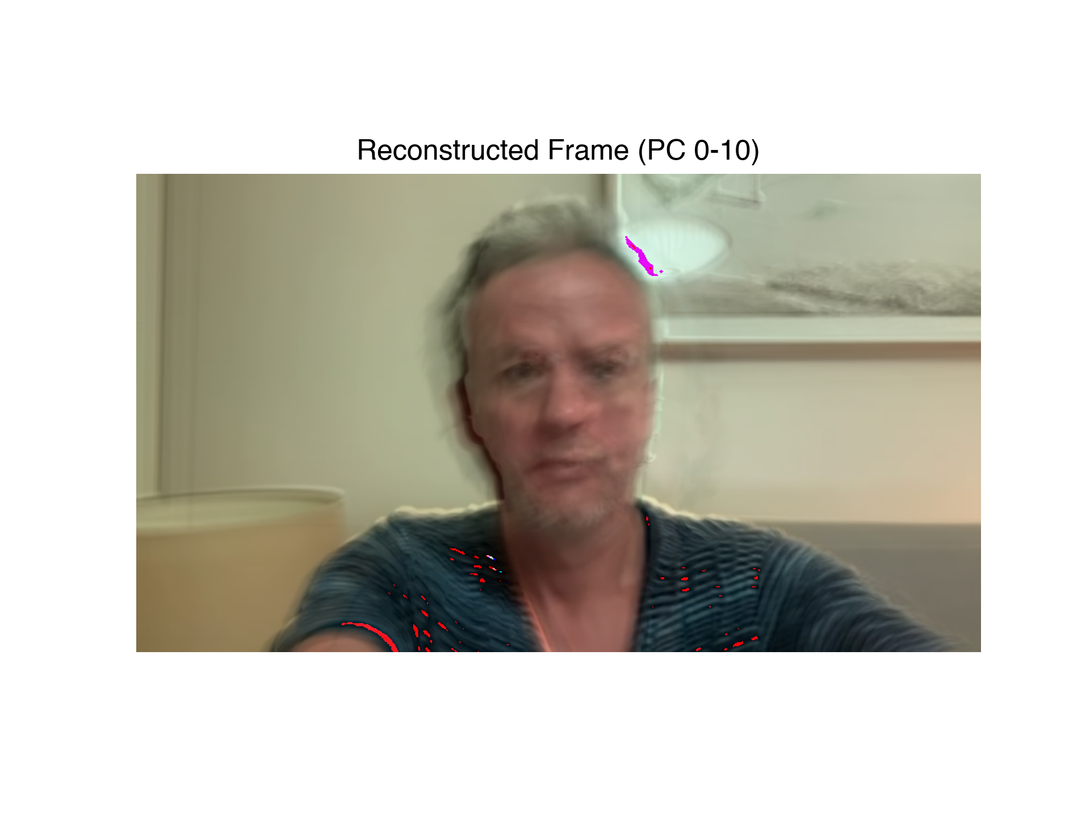
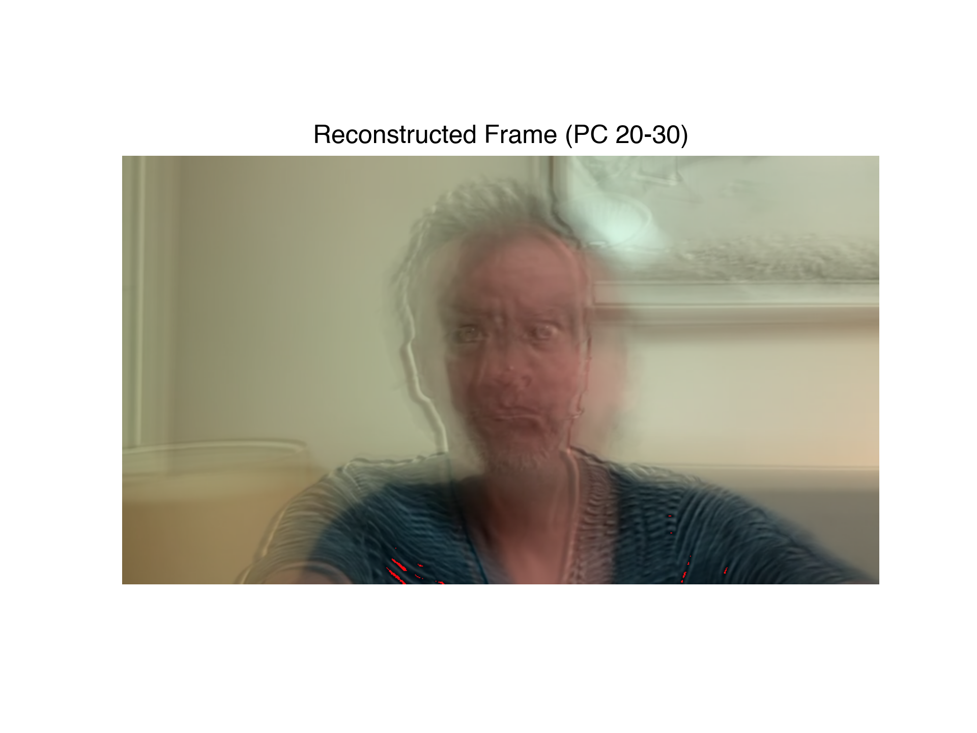
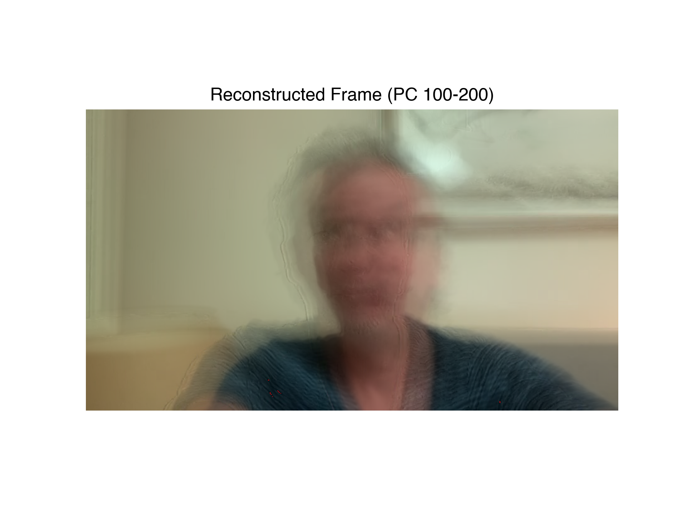
Your Essence

Slide 18
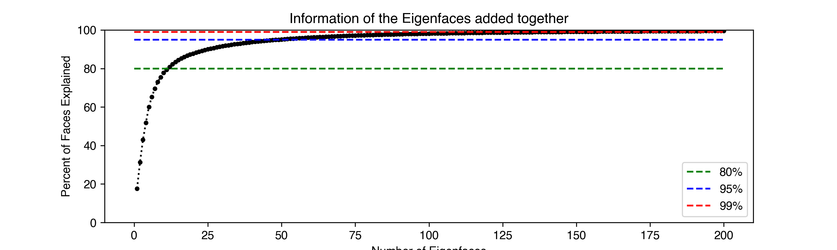
Add Them All Together
+
+
+
=

Slide 19
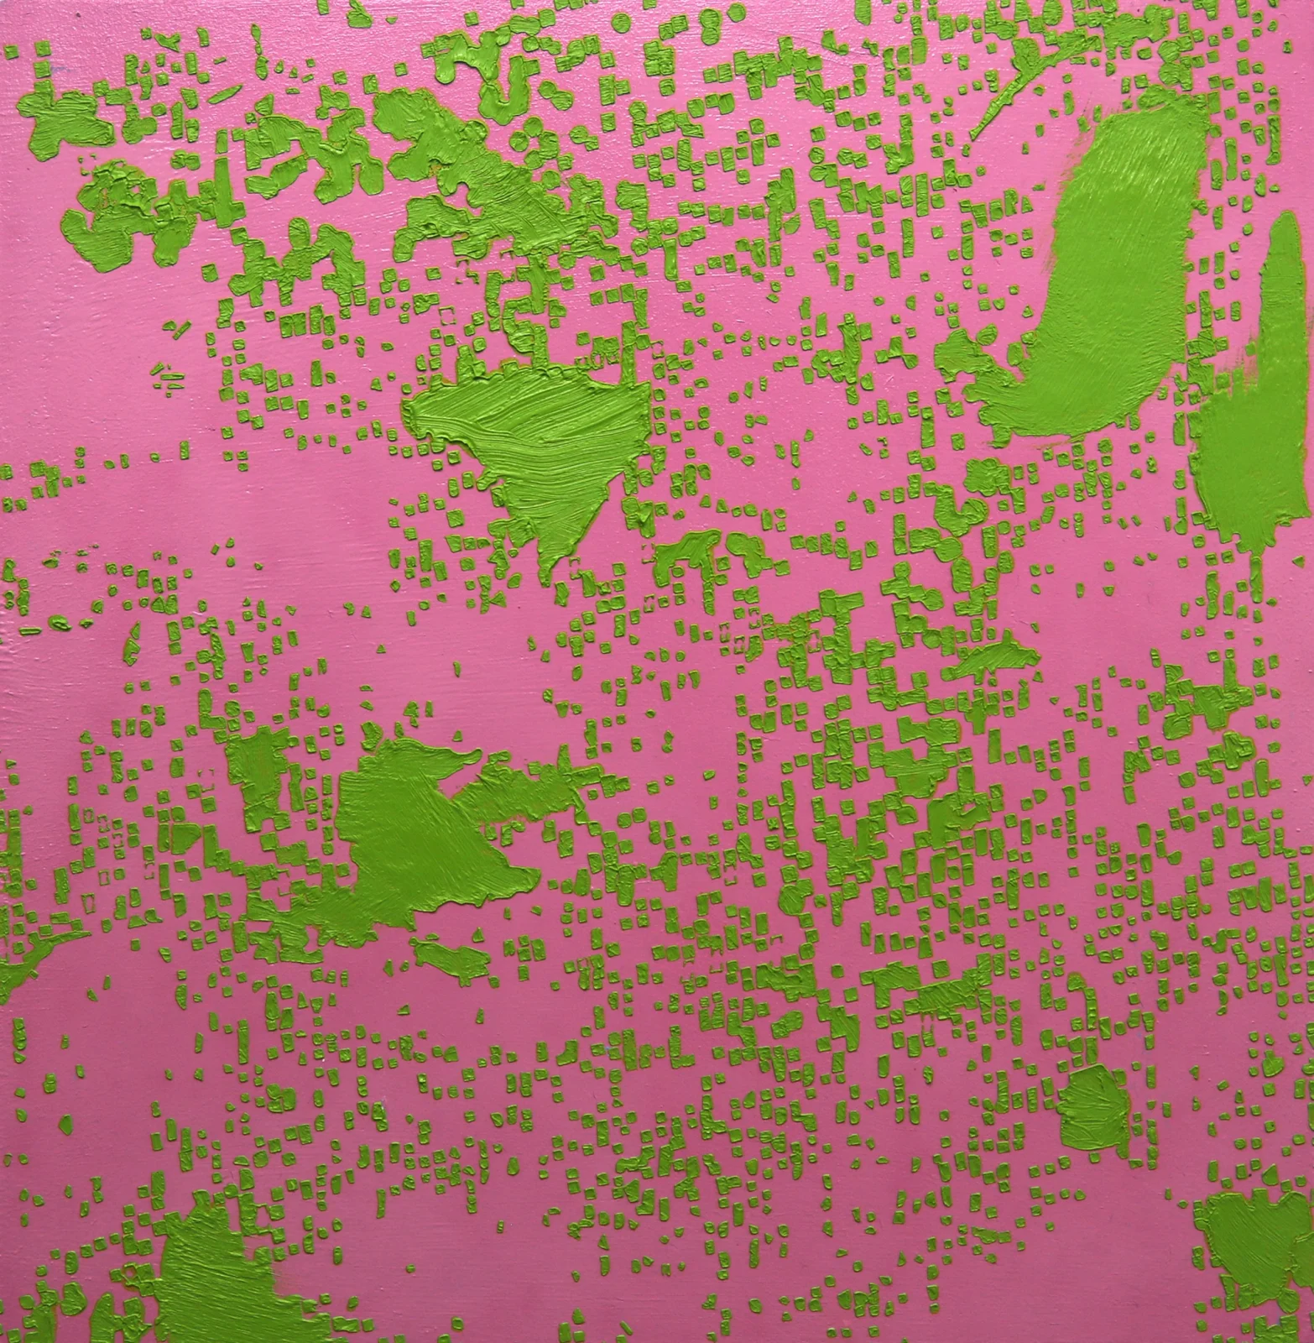
Conclusion
Science of Face Recognition overlaps with many different disciplines: Maths, Art, Neuroscience, Computer Science
Not many images to recognize you
Not many images needed to make a version of you
HUMAN FACES, RUBBER DUCKS AND OTHER MISUNDERSTANDINGS V, 2024

Slide 20
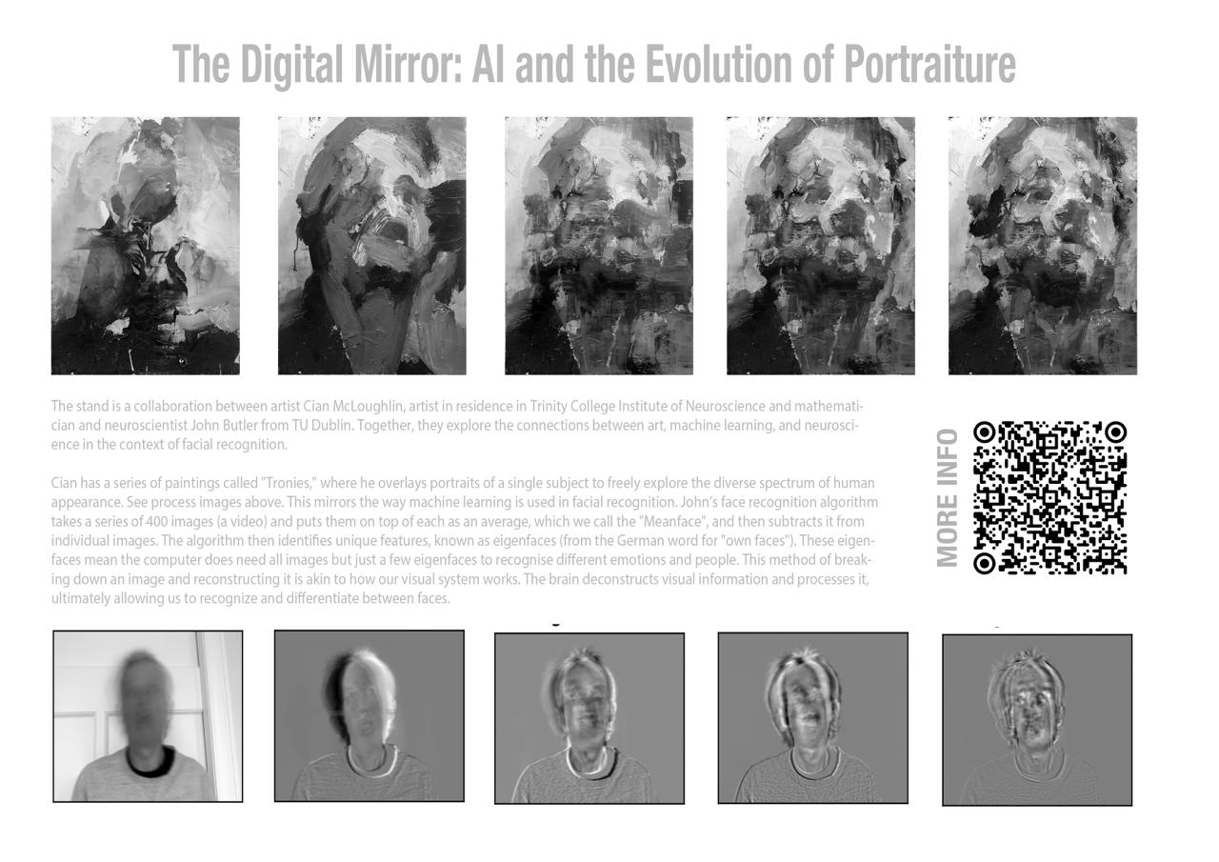
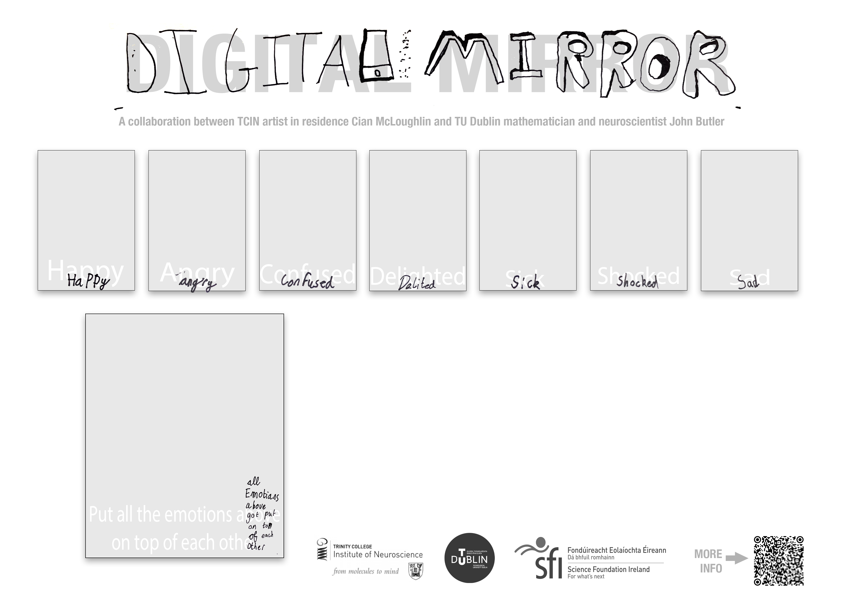
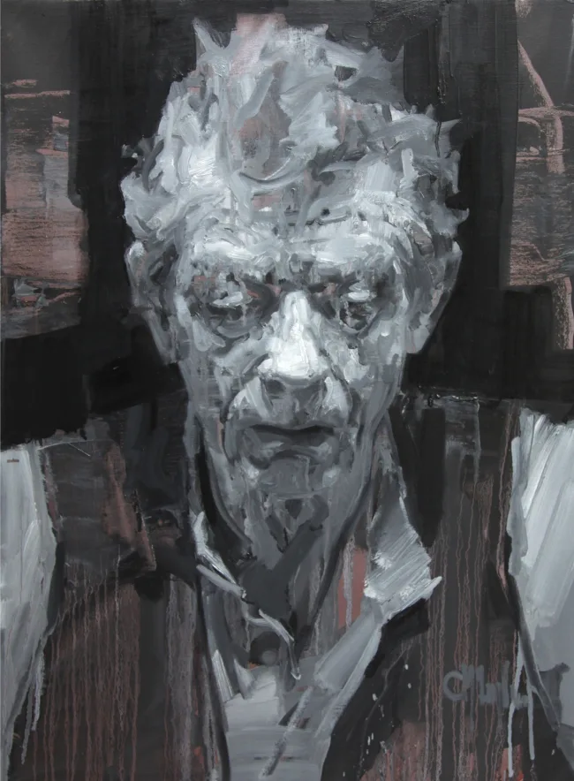
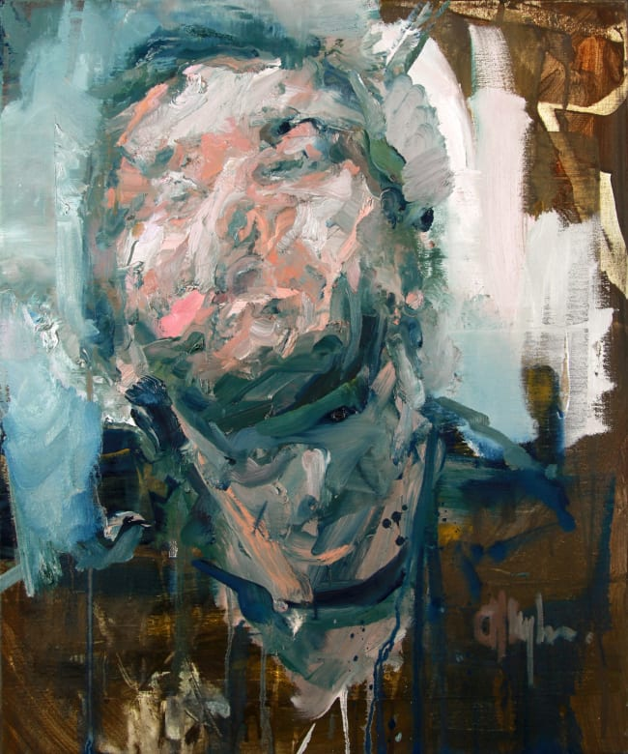
Thank you for Listening

Slide 21
Selected Publications for everyone
Brady R., Butler, J.S., (2022) “The Circle of Life: The Mathematics of Predator-Prey Dynamics” Frontiers for Young Minds doi: 10.3389/frym.2021.651131
McCrann, S., Loughman, J., Butler, J.S., Paudel, N. and Flitcroft, D.I. (2021), Do smartphones hurt our eyes by causing shortsightedness? Frontiers for Young Minds https://doi: 10.3389/frym.2021.56985
Campos J, Pandi M and Butler JS (2020) “Feeling Ourselves Move: A Team Effort by Our Senses.” Front. Young Minds. 8:9. doi: 10.3389/frym.2020.00009

Slide 22
The Full Algorithm

Slide 23
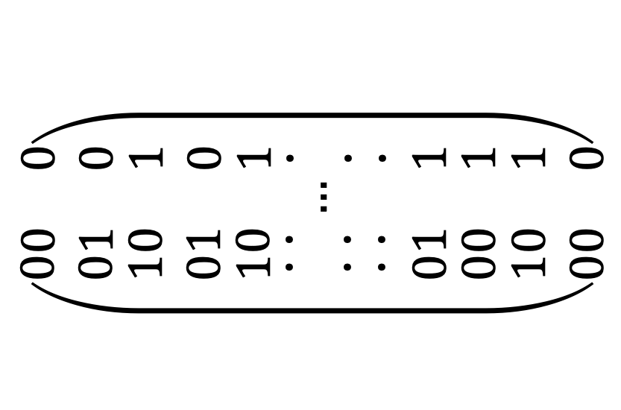
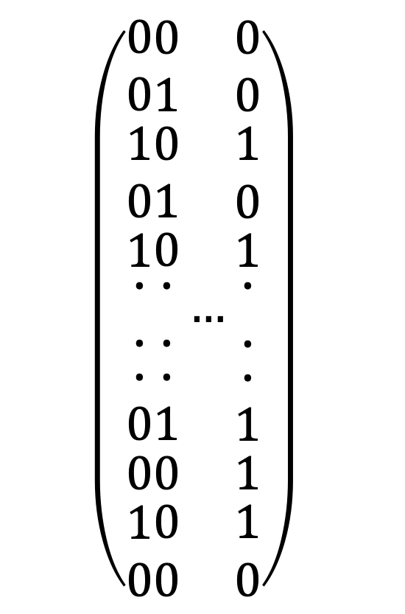
All Together Now
$$\left(\begin{matrix}\begin{matrix}\begin{matrix}\begin{matrix}0 \\ 0\end{matrix} \\ \begin{matrix}1 \\ 0\end{matrix}\end{matrix} \\ 1\end{matrix} \\ \begin{matrix}\begin{matrix}\begin{matrix}\begin{matrix}∙ \\ ∙\end{matrix} \\ ∙\end{matrix} \\ 0\end{matrix} \\ \begin{matrix}0 \\ \begin{matrix}1 \\ 0\end{matrix}\end{matrix}\end{matrix}\end{matrix}\begin{matrix}\begin{matrix}\begin{matrix}\begin{matrix}0 \\ 1\end{matrix} \\ \begin{matrix}0 \\ 1\end{matrix}\end{matrix} \\ 0\end{matrix} \\ \begin{matrix}\begin{matrix}\begin{matrix}\begin{matrix}∙ \\ ∙\end{matrix} \\ ∙\end{matrix} \\ 1\end{matrix} \\ \begin{matrix}0 \\ \begin{matrix}0 \\ 0\end{matrix}\end{matrix}\end{matrix}\end{matrix}…\begin{matrix}\begin{matrix}\begin{matrix}\begin{matrix}0 \\ 0\end{matrix} \\ \begin{matrix}1 \\ 0\end{matrix}\end{matrix} \\ 1\end{matrix} \\ \begin{matrix}\begin{matrix}\begin{matrix}\begin{matrix}∙ \\ ∙\end{matrix} \\ ∙\end{matrix} \\ 1\end{matrix} \\ \begin{matrix}1 \\ \begin{matrix}1 \\ 0\end{matrix}\end{matrix}\end{matrix}\end{matrix}\right)$$
$$\left(\begin{matrix}\begin{matrix}\begin{matrix}\begin{matrix}0 \\ 0\end{matrix} \\ \begin{matrix}1 \\ 0\end{matrix}\end{matrix} \\ 1\end{matrix} \\ \begin{matrix}\begin{matrix}\begin{matrix}\begin{matrix}∙ \\ ∙\end{matrix} \\ ∙\end{matrix} \\ 0\end{matrix} \\ \begin{matrix}0 \\ \begin{matrix}1 \\ 0\end{matrix}\end{matrix}\end{matrix}\end{matrix}\begin{matrix}\begin{matrix}\begin{matrix}\begin{matrix}0 \\ 1\end{matrix} \\ \begin{matrix}0 \\ 1\end{matrix}\end{matrix} \\ 0\end{matrix} \\ \begin{matrix}\begin{matrix}\begin{matrix}\begin{matrix}∙ \\ ∙\end{matrix} \\ ∙\end{matrix} \\ 1\end{matrix} \\ \begin{matrix}0 \\ \begin{matrix}0 \\ 0\end{matrix}\end{matrix}\end{matrix}\end{matrix}…\begin{matrix}\begin{matrix}\begin{matrix}\begin{matrix}0 \\ 0\end{matrix} \\ \begin{matrix}1 \\ 0\end{matrix}\end{matrix} \\ 1\end{matrix} \\ \begin{matrix}\begin{matrix}\begin{matrix}\begin{matrix}∙ \\ ∙\end{matrix} \\ ∙\end{matrix} \\ 1\end{matrix} \\ \begin{matrix}1 \\ \begin{matrix}1 \\ 0\end{matrix}\end{matrix}\end{matrix}\end{matrix}\right)$$

Slide 24
Variance
A co-variance matrix multiply

Slide 25
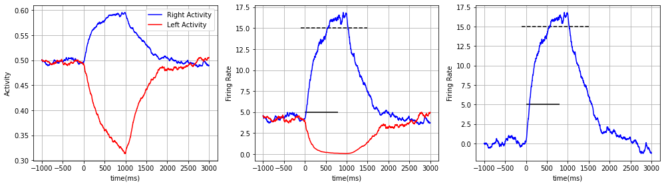
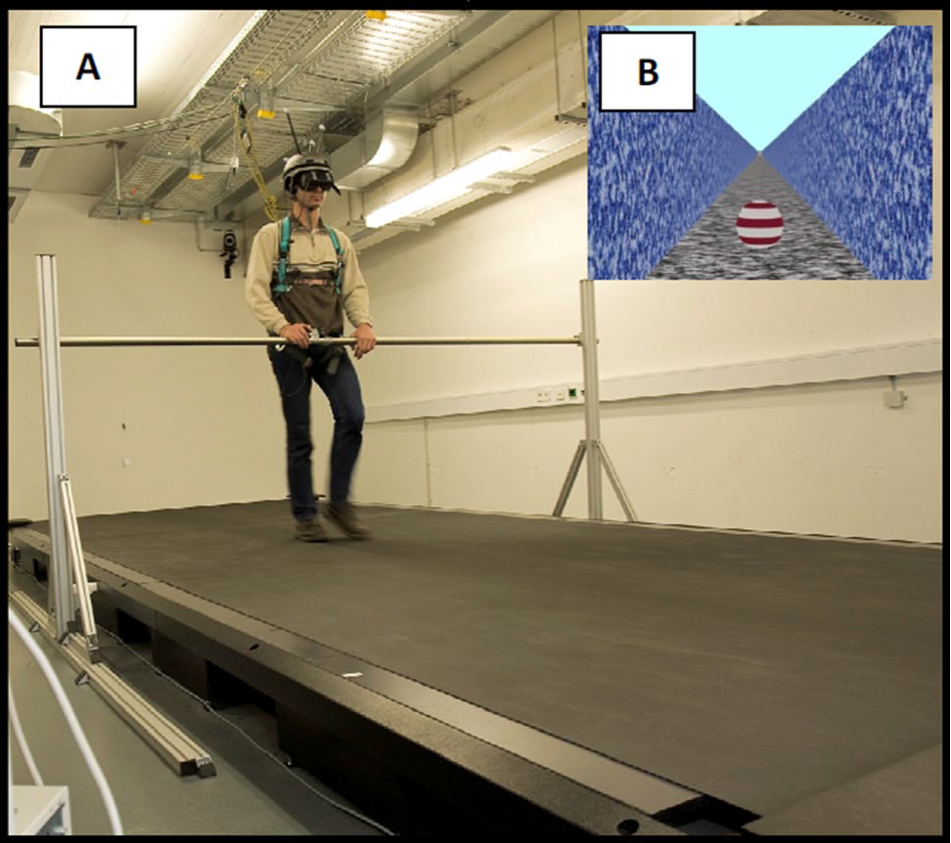
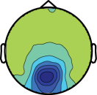
John Butler
Lecturer in School of Mathematics and Statistics (TU Dublin, 2016-)
Adjunct Assistant Professor in Physiology (TCD, 2016-)
How Did I Get Here:
PhD in Computational Fluid Dynamics (TCD, 2001-2006)
Research on how we interact with our environment (Germany, 2006-2009)
Research on sensory processing in people with Autism (USA, 2009-2013)
Research on movement disorders (TCD, 2013-2015)
Published over 70 research papers in international journals, 14 PhD Students, 11 MSc Student, 17 Undergraduate Students

Slide 26
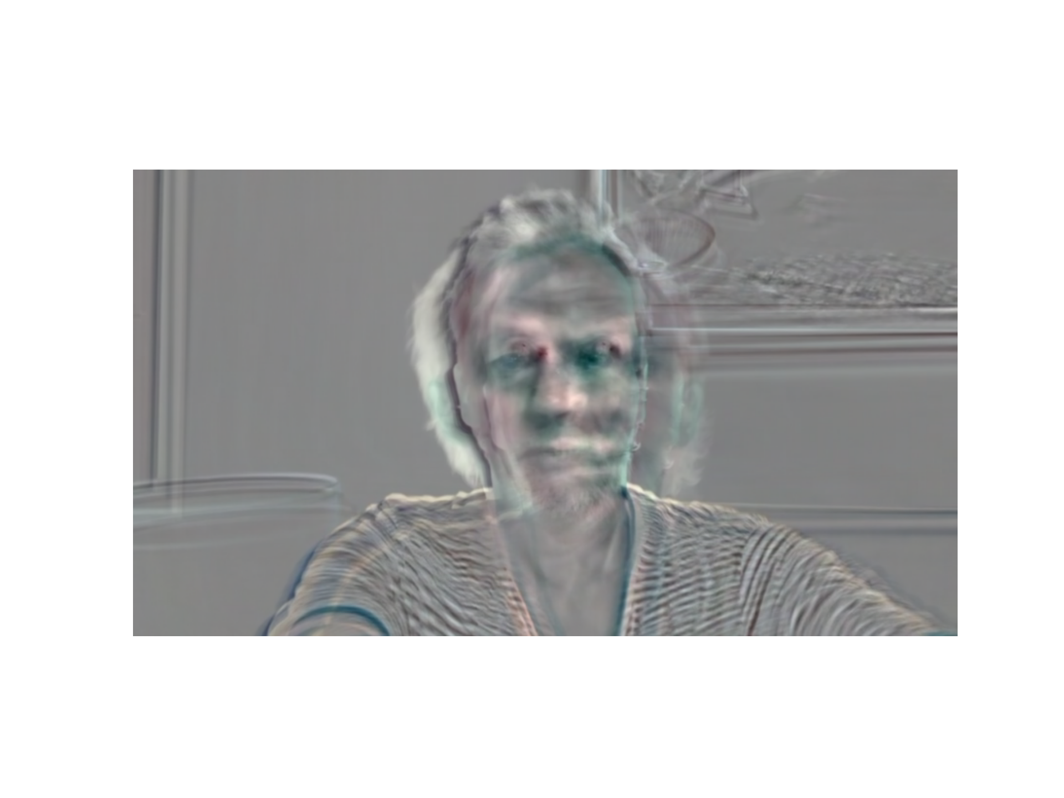






Who Do I Research With
My Research
Art
Neuroscience
Physics
Mathematics
Psychology
Electrical Engineering
Medicine
Computer Science

Slide 27
Face Recognition

Slide 28

Who Do I Look Like?

